Slide 1
Network Analysis using Reddit
Raymond Mead

Slide 2
Background on Reddit
Popular Entertainment/News/Social website
29th most popular in world
Content is entirely user driven
Reddit has lots of sub-communities (subreddits)
Users run and operate communities (create and moderate)
Posts with comments, and voting in each community
People subscribe to communities to see posts
Interesting source for user behavior
What types of patterns would this behavior drive?

Slide 3
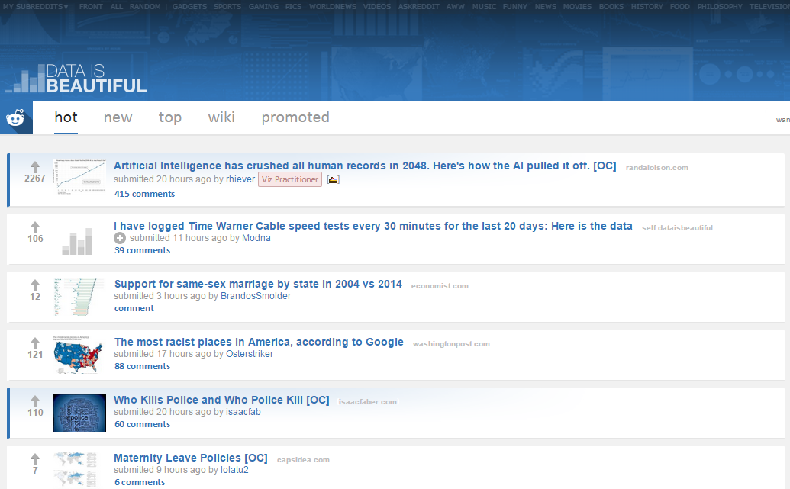

Slide 4
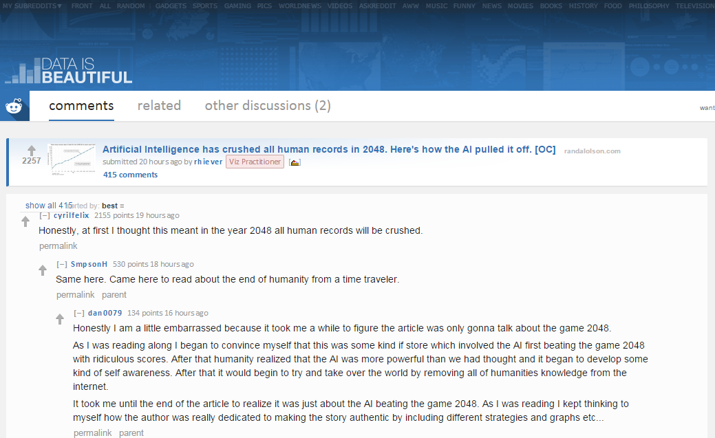

Slide 5
Exploratory Questions
How did popularity of various communities change throughout the year?
Did communities grow together?
Does Jaccard similarity influence activity in similar communities?
What were some interesting things that could be seen about 2014 from Reddit activity?

Slide 6
Methods
Looked at 562 communities (all over 50,000 subscribers)
Up to 250 posts/month for every month in 2014 for each community
Measured activity using the number of users who posted
For each post gathered comment data, and post data
Post Data: time, author, votes, #comments, link
Comment Data: users and #comments/user
Total posts ≈ 1.6 million
Total users ≈ 2.9 million
Used python web-scraper to gather info

Slide 7
Most Similar
Subreddit | Subreddit | Jaccard Similarity | Comments
britishproblems, | Unitedkingdom | .195 | Both British
Darksouls | Darksouls2 | .193 | Game and Sequel
AskMen | AskWomen | .191 | You never know who is a guy or girl
Nintendo | Wiiu | .183 | Nintendo related
Autos | cars | .178 | Car related
CFB | CollegeBasketball | .174 | College Sports
Asoiaf | gameofthrones | .171 | Game of thrones book and show
Webdev | Web_design | .168 | Web development
Business | Economics | .163 | Business and Econ
3DS | wiiu | .161 | Nintendo related

Slide 8
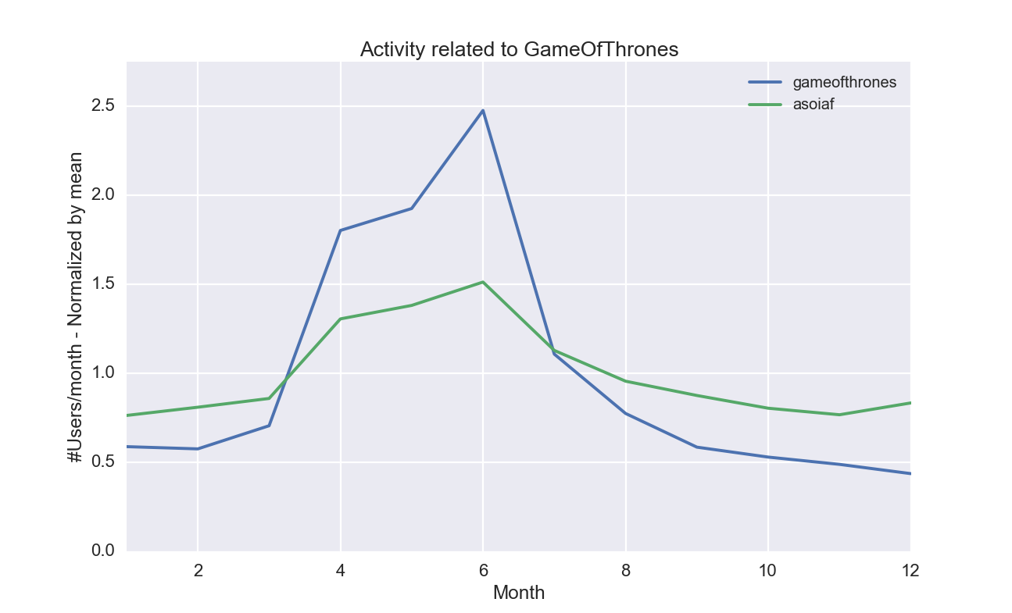
Game of Thrones

Slide 9
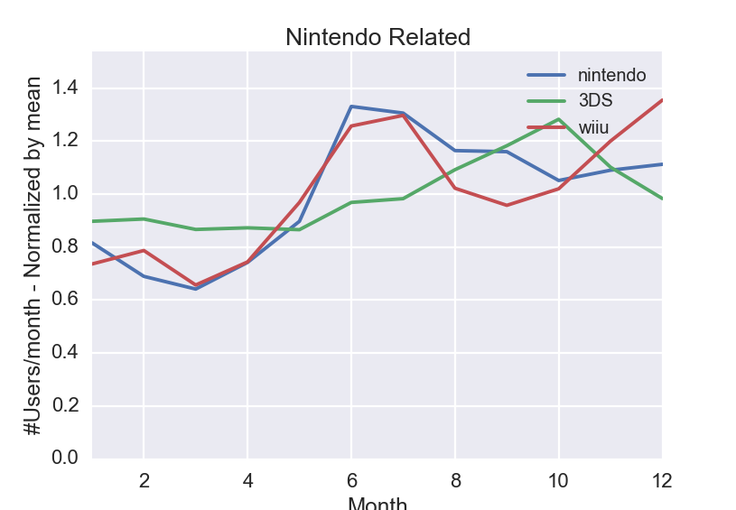
Nintendo

Slide 10
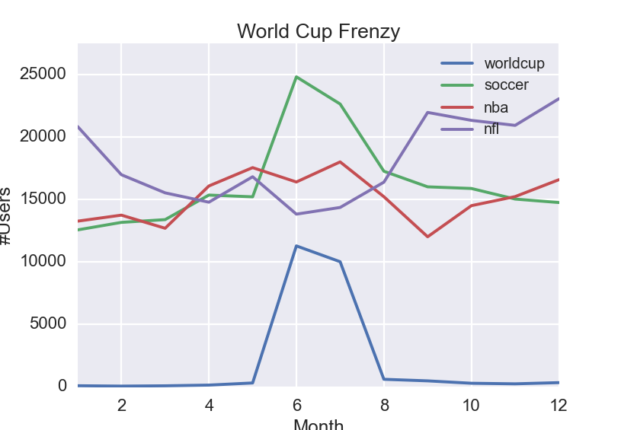
WorldCup

Slide 11
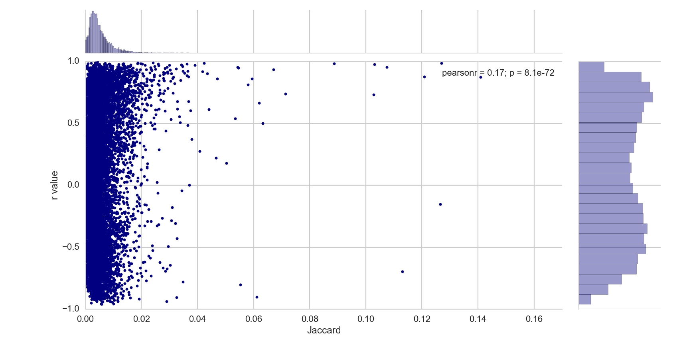
Correlation & Jaccard Sim

Slide 12
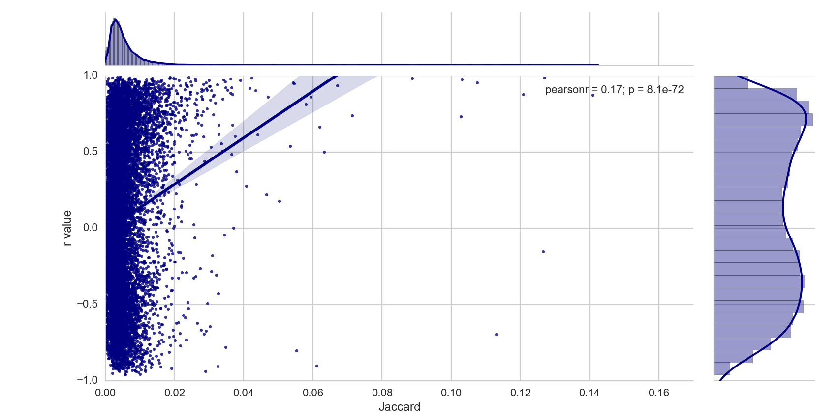
Correlation & Jaccard Sim

Slide 13
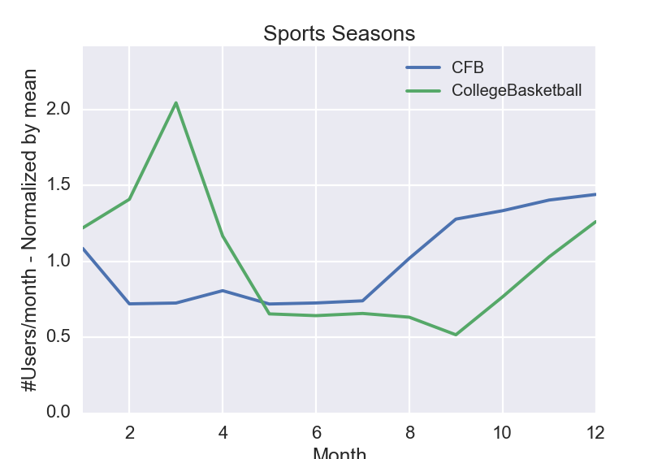
CFB and CollegeBasketball

Slide 14
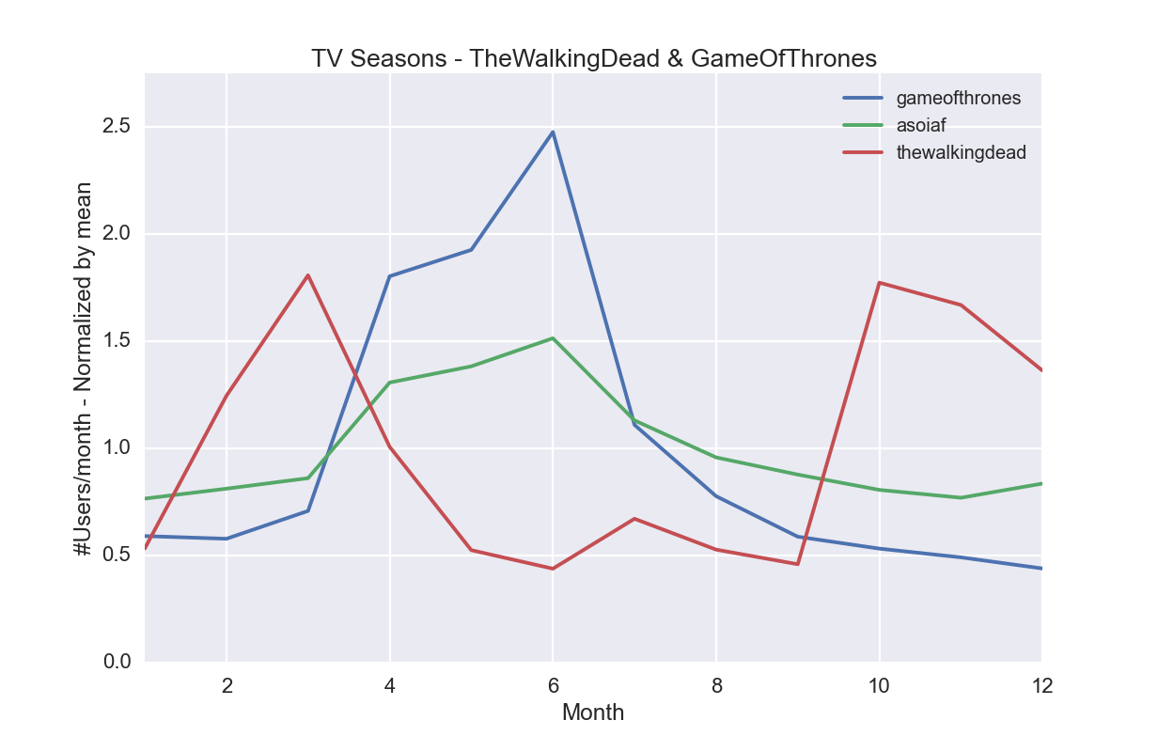
T.V. Show Seasons

Slide 15
What was found
There are some close activity relationships, but they tend to be the exceptions, and not the rule
There is still a decent amount of correlation between community interaction, and activity
In some cases there are closely related communities. But they have activity in different seasons
Most communities tend to be relatively stable over the course of the year
The activity of various subreddits still sheds light on how certain communities work

Slide 16
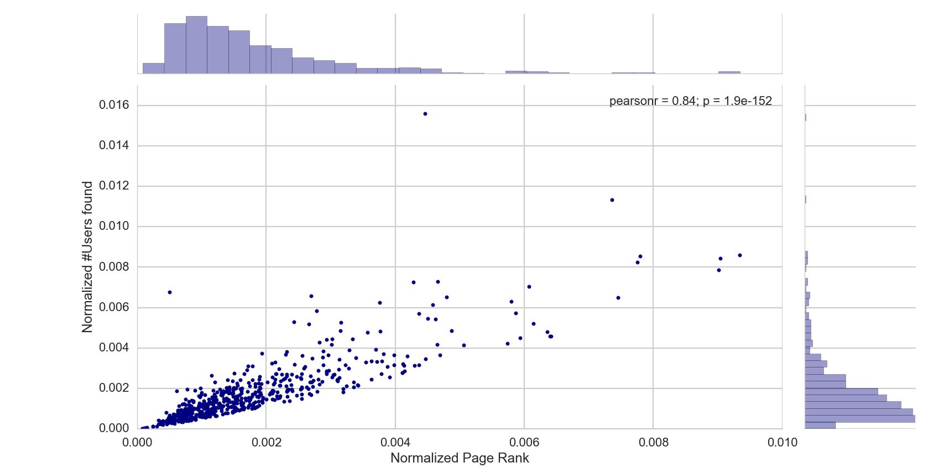
PageRank
Notes:
Top Outlier – league of legends, left outlier – friend safari
pagerank shows relative influence on rest of the community

Slide 17
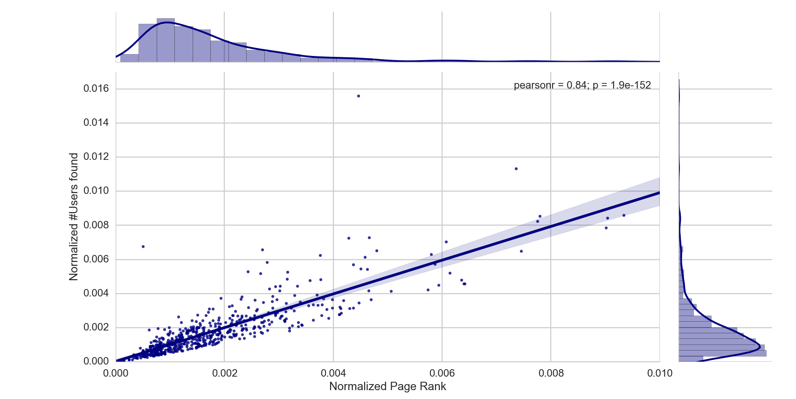
PageRank

Slide 18
Interpretation
Note: Transition probabilities were proportional to the size of the intersection with the other community
PageRank shows the relative influence on the community
There are not many with high PageRank and low size, which shows its hard to have influential communities without being large.
There are some large communities though that have a low PageRank, which shows that despite their size, they do not influence much.

Slide 19
Extras

Slide 20
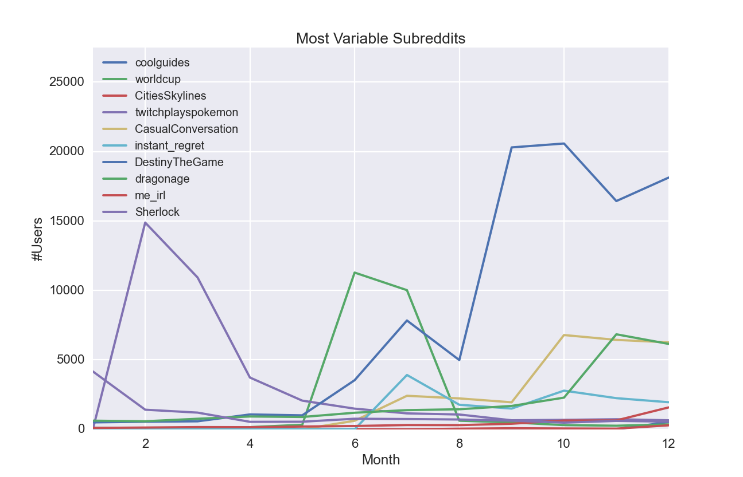
Most Fluctuating Communities

Slide 21
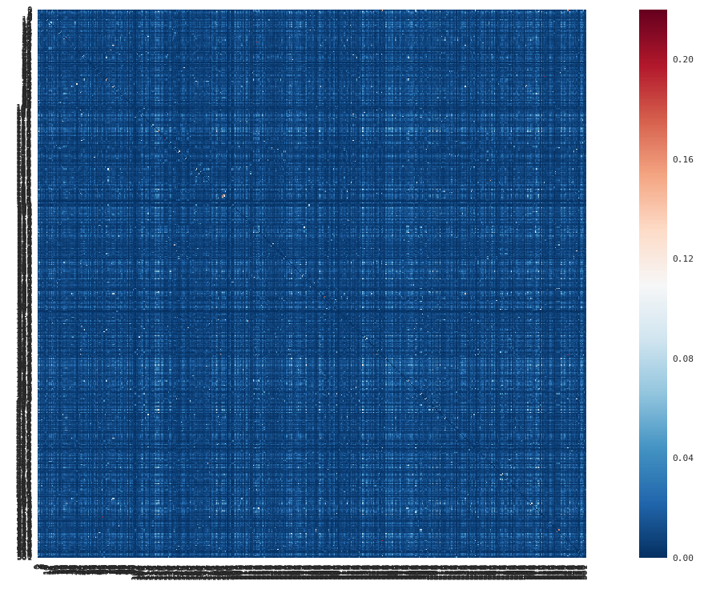
Community Similarity Matrix

Slide 22
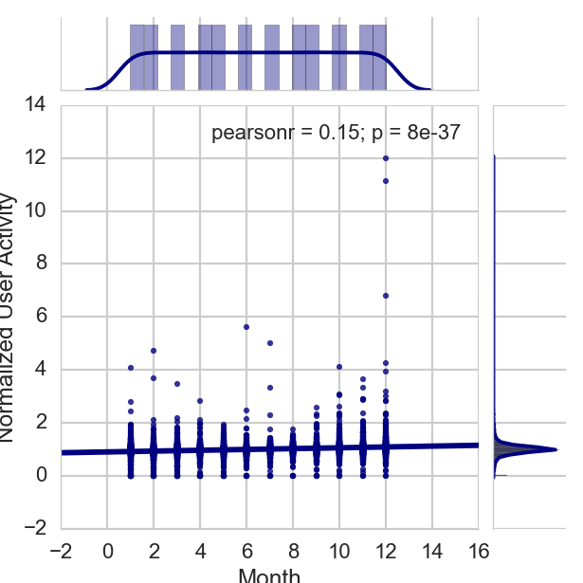
Normalized User Activity

